Slide 1
MRI Homework4
報告者：王韵雯
日期：2015/12/22

Slide 2
Outline
Software
FSL
Example real fmri-fluency dataset
Featquery
High-resolution Single-Session Overlays
Custom Waveforms

Slide 3
Software
VMware Player 12.0.0
Ubuntu 15.04
FSL

Slide 4
FSL
. /etc/fsl/5.0/fsl.sh
Feat &
Featquery &
Renderhighres &

Slide 5
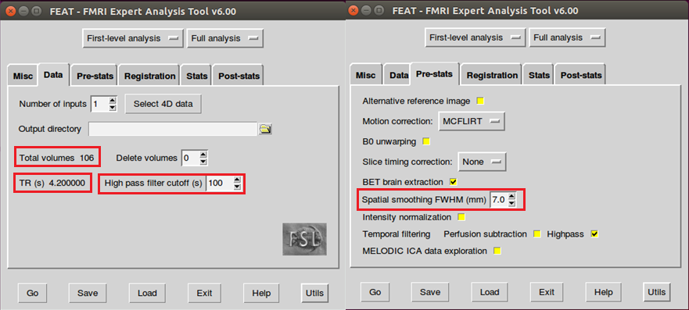
Example real fmri-fluency dataset

Slide 6
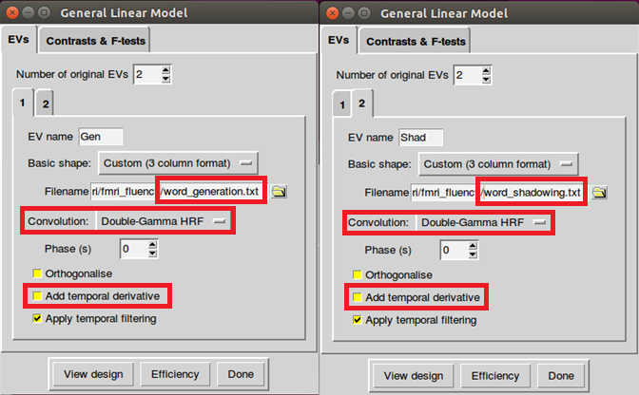
Example real fmri-fluency dataset

Slide 7
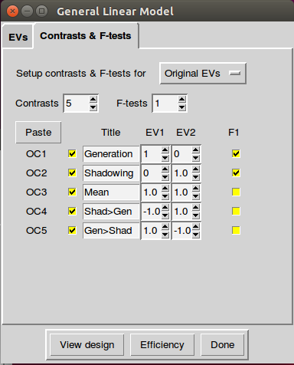
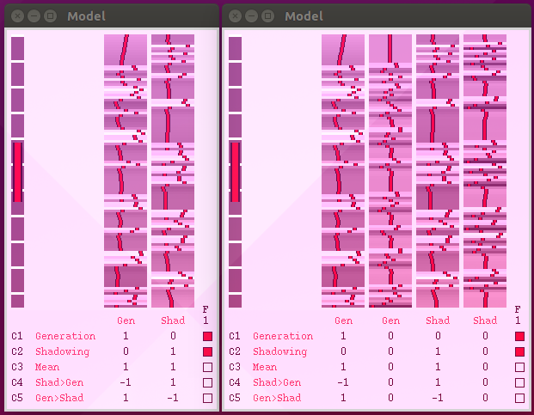
Example real fmri-fluency dataset

Slide 8
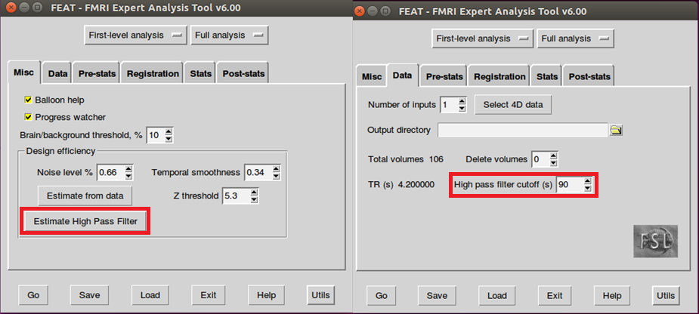
Example real fmri-fluency dataset

Slide 9
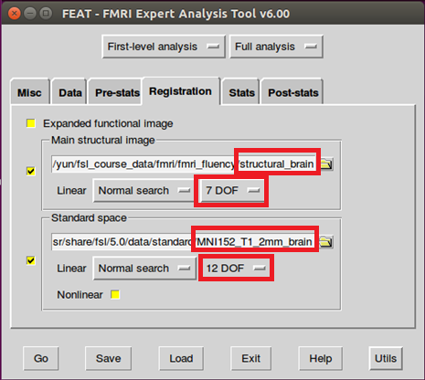
Example real fmri-fluency dataset

Slide 10
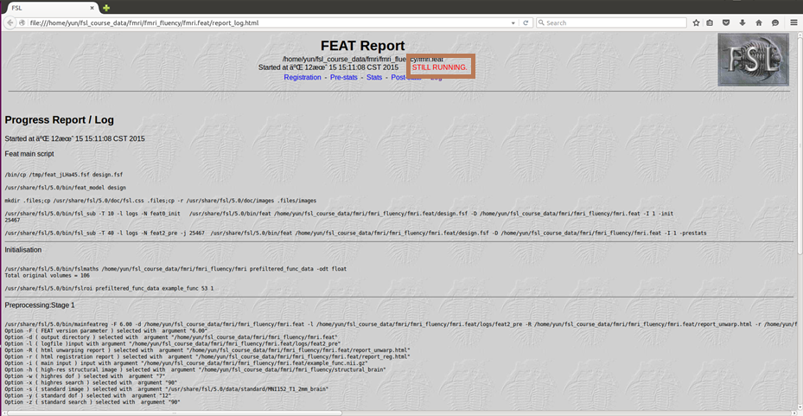
Example real fmri-fluency dataset

Slide 11
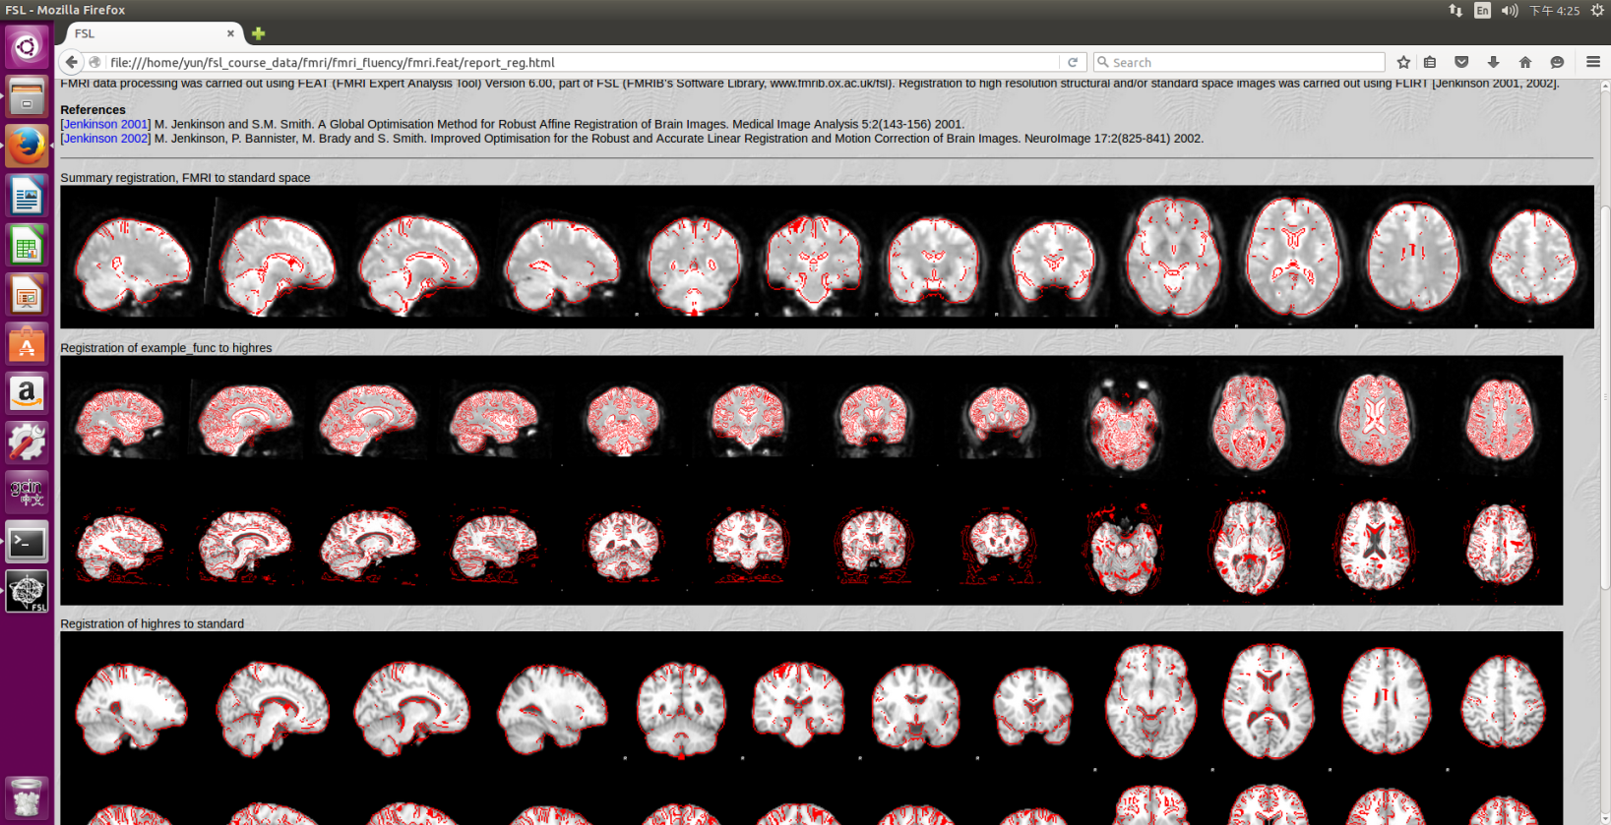
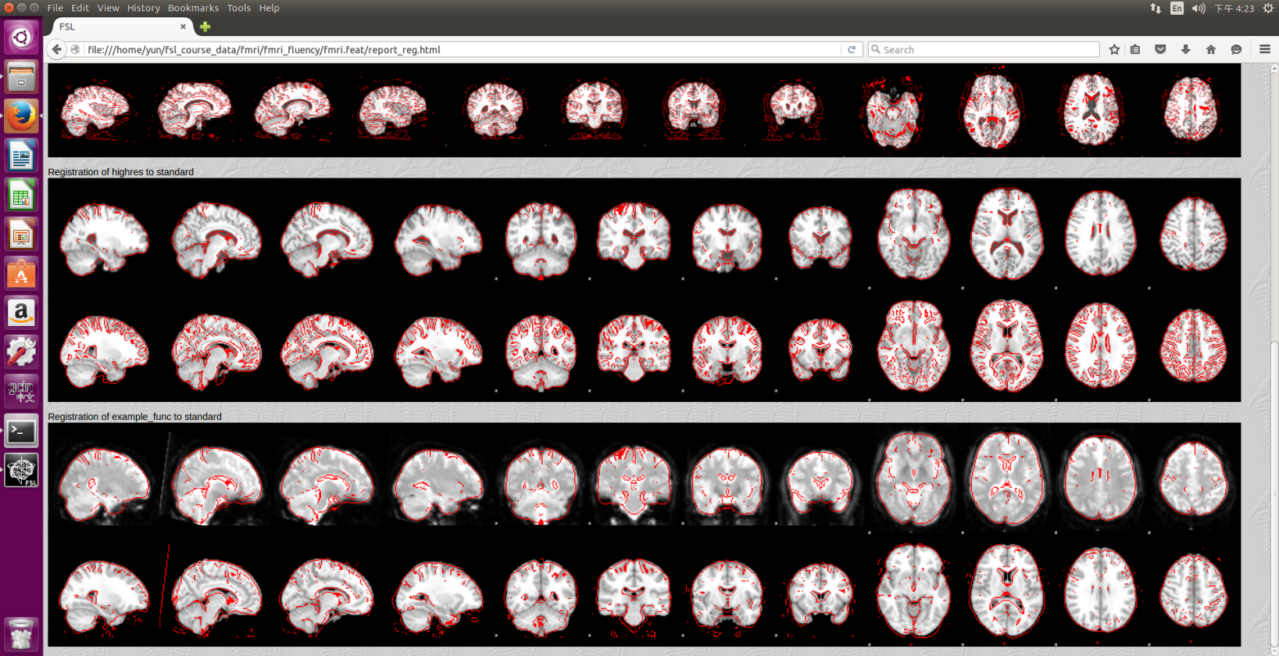
Example real fmri-fluency dataset

Slide 12
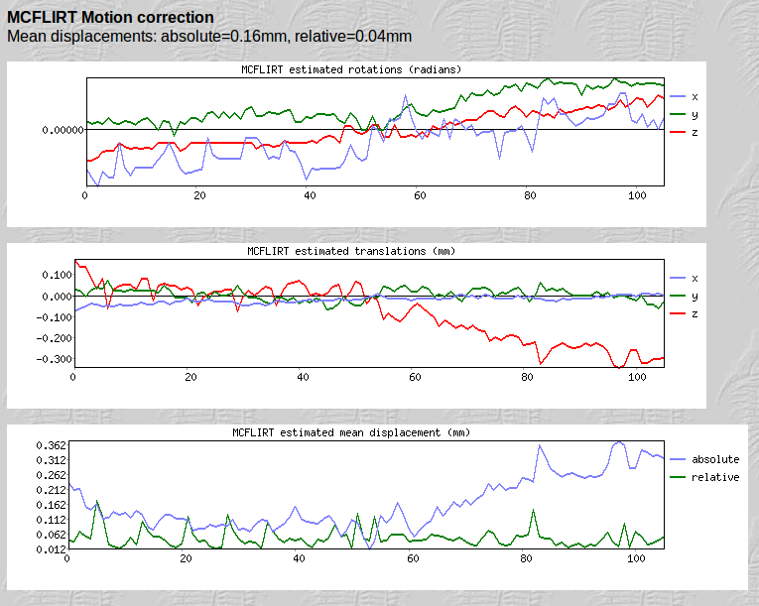
Example real fmri-fluency dataset

Slide 13
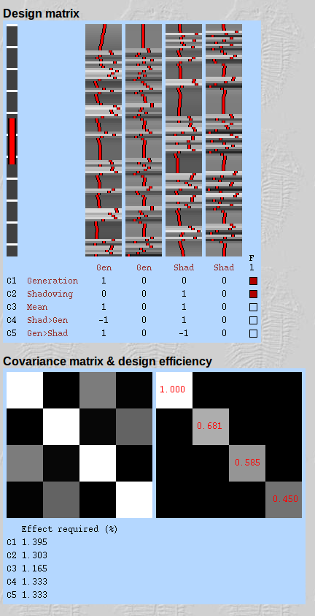
Example real fmri-fluency dataset

Slide 14
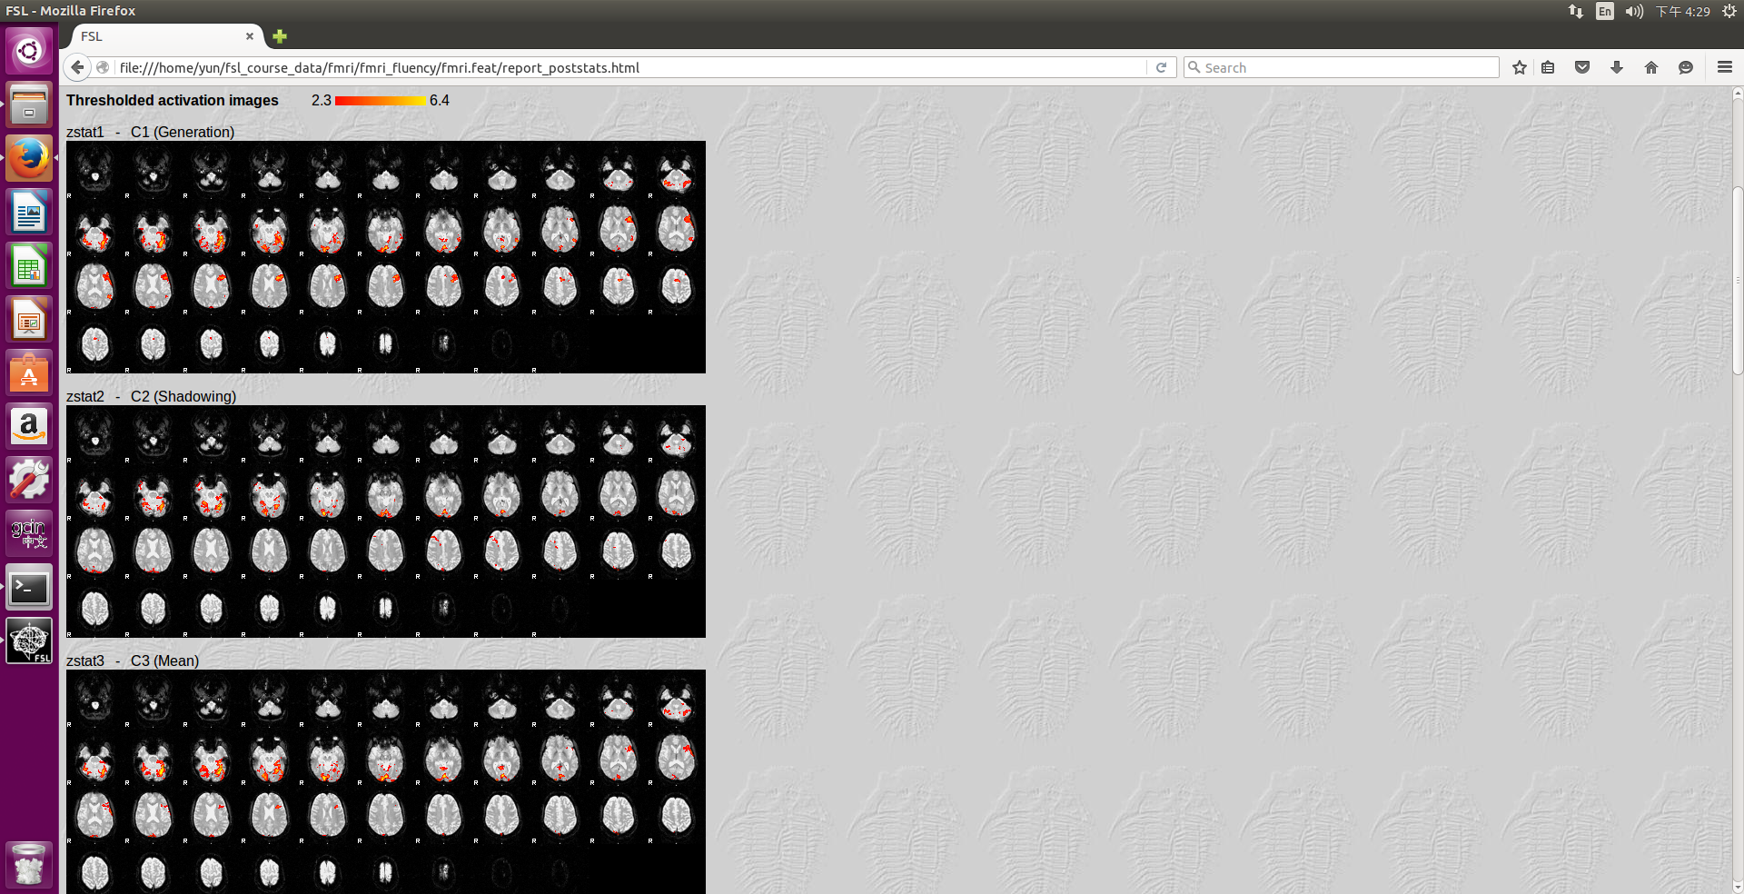
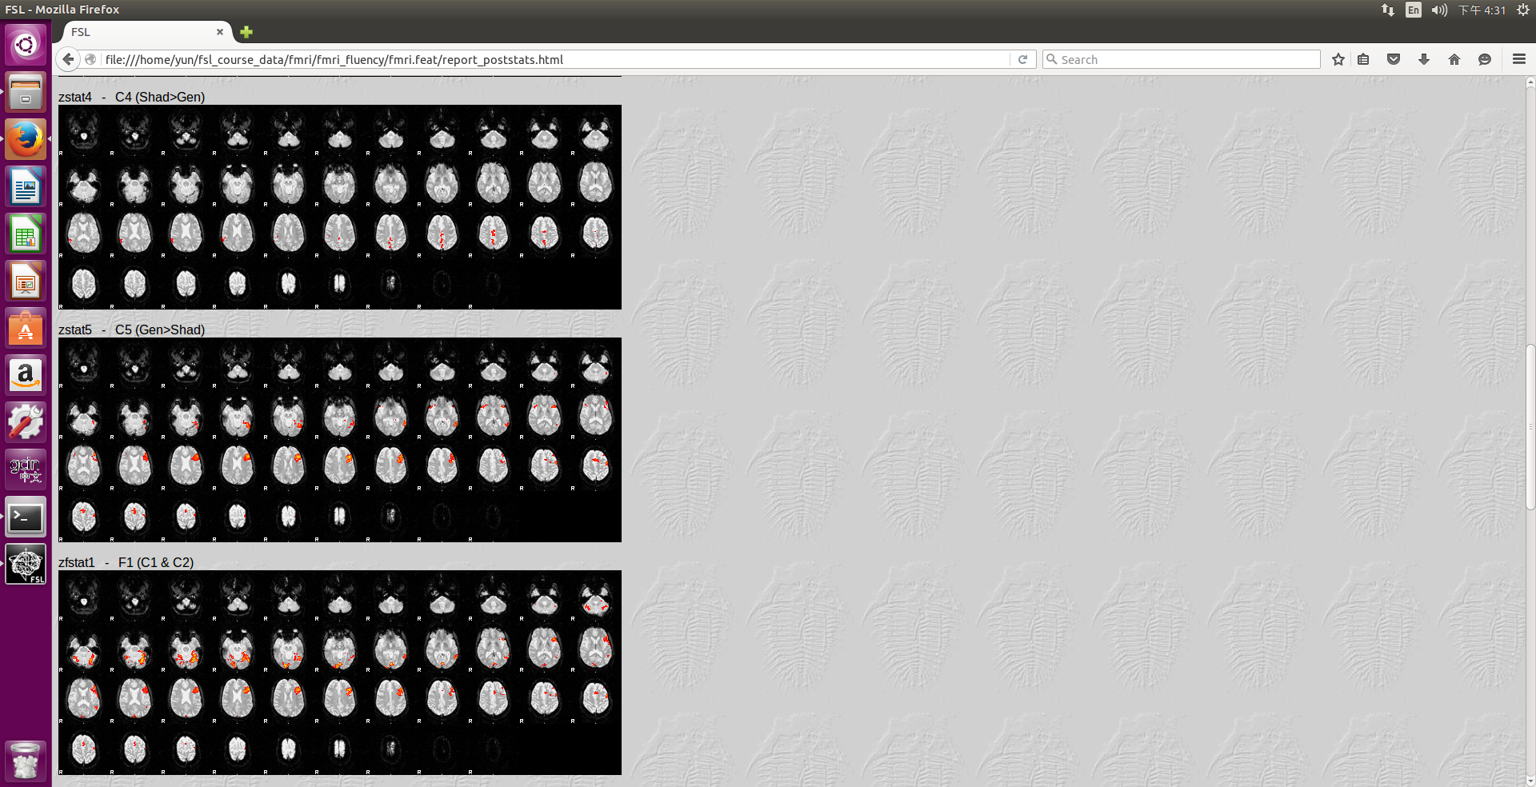
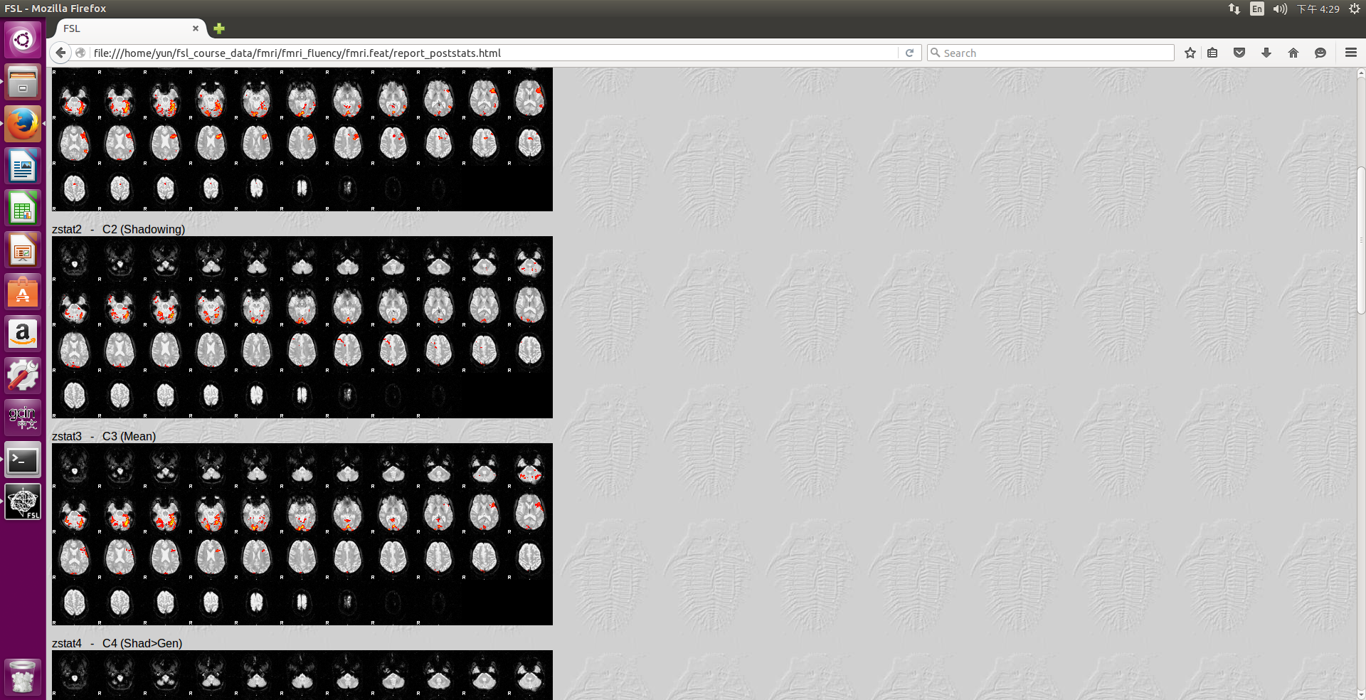
Example real fmri-fluency dataset

Slide 15
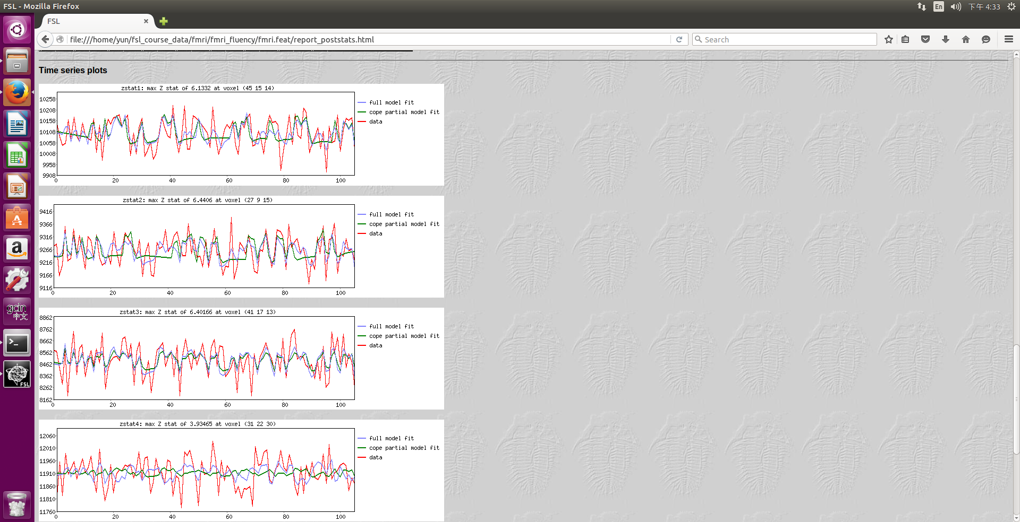
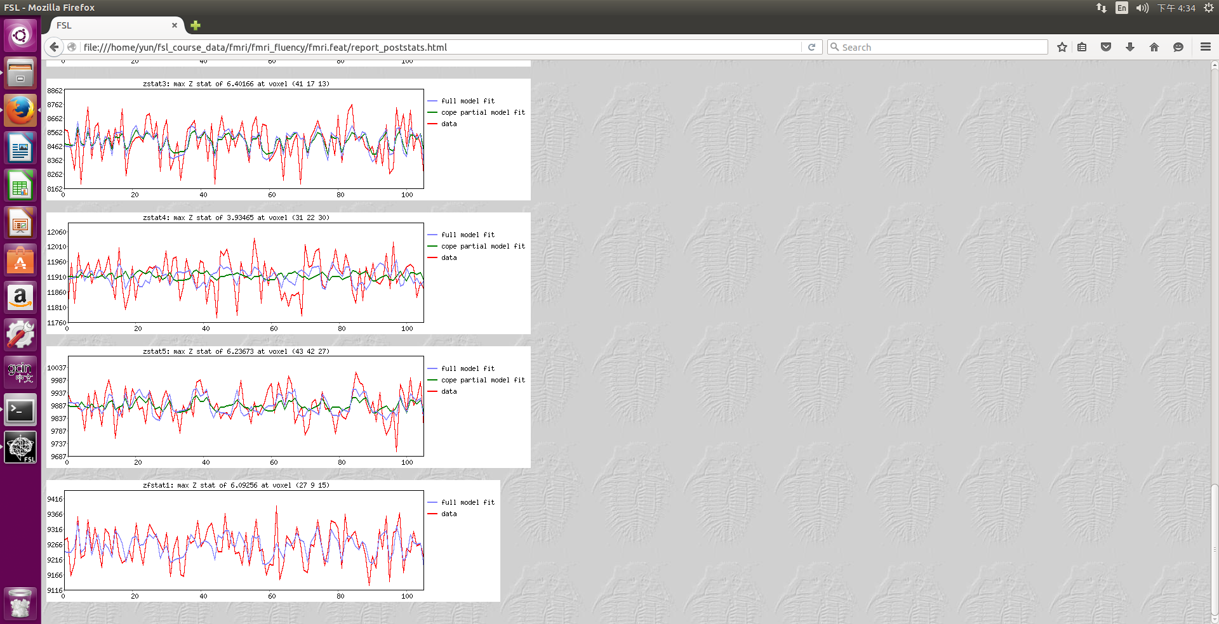
Example real fmri-fluency dataset

Slide 16
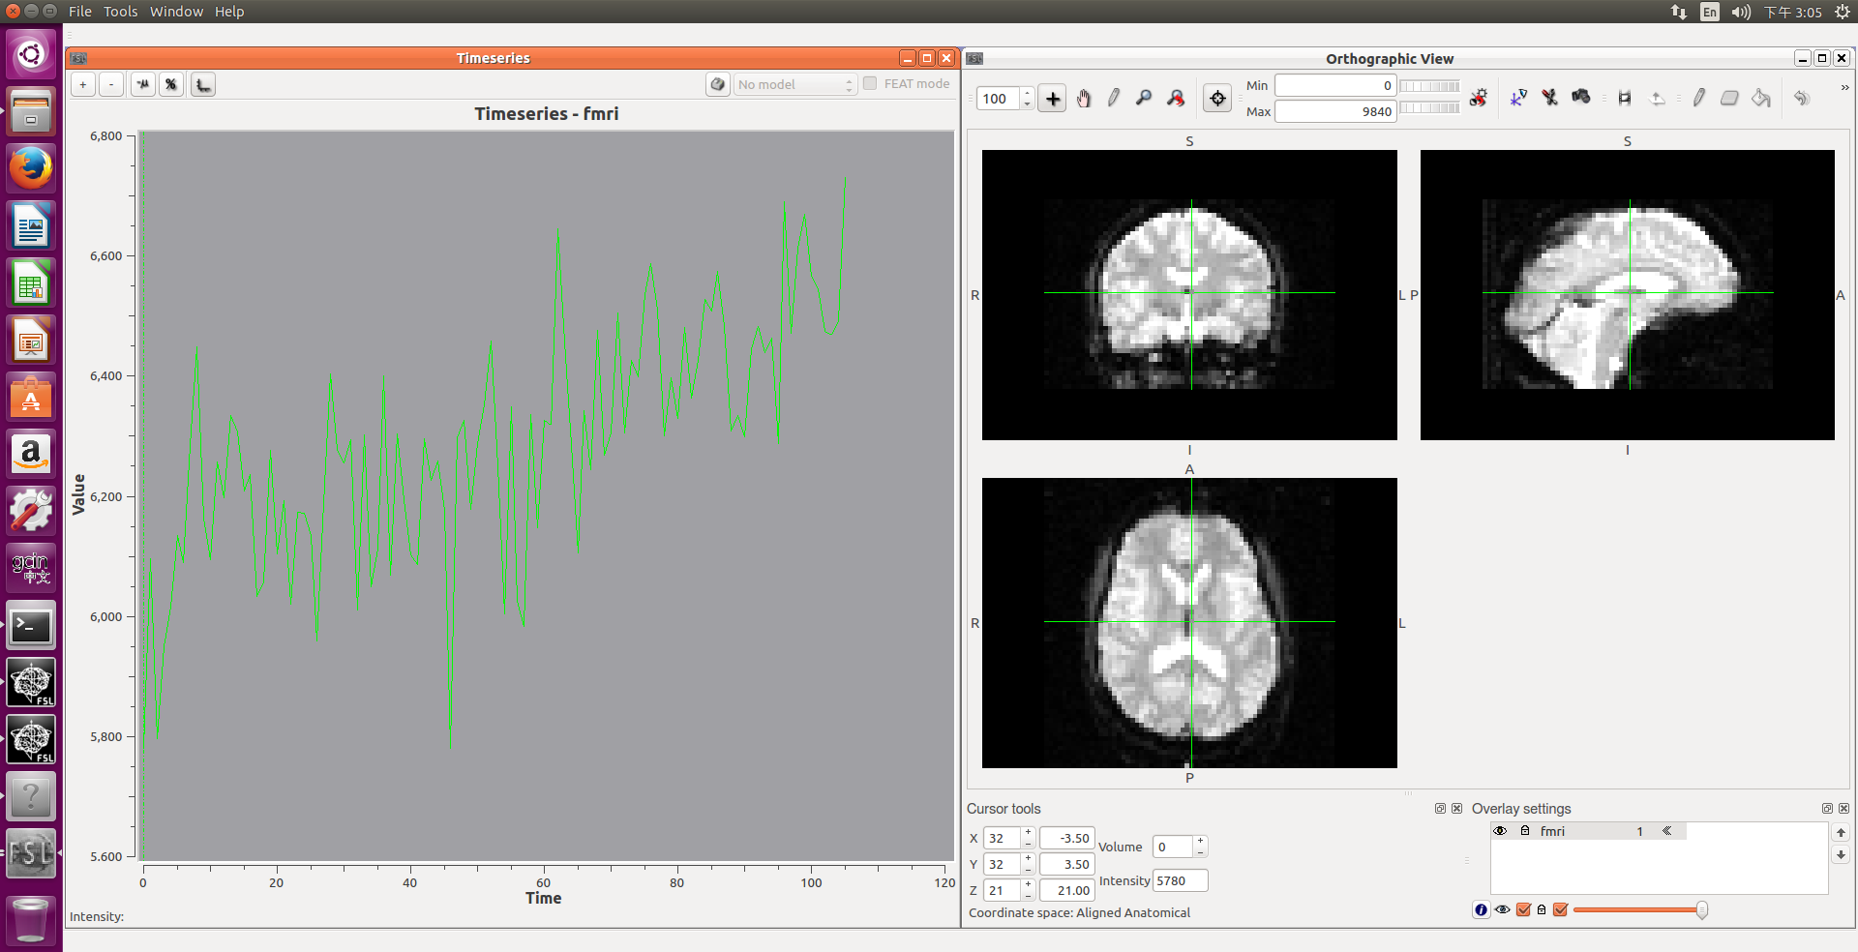
Example real fmri-fluency dataset

Slide 17
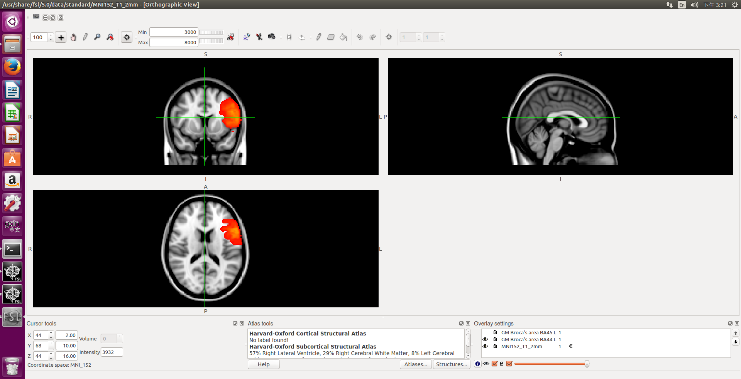
Example real fmri-fluency dataset

Slide 18
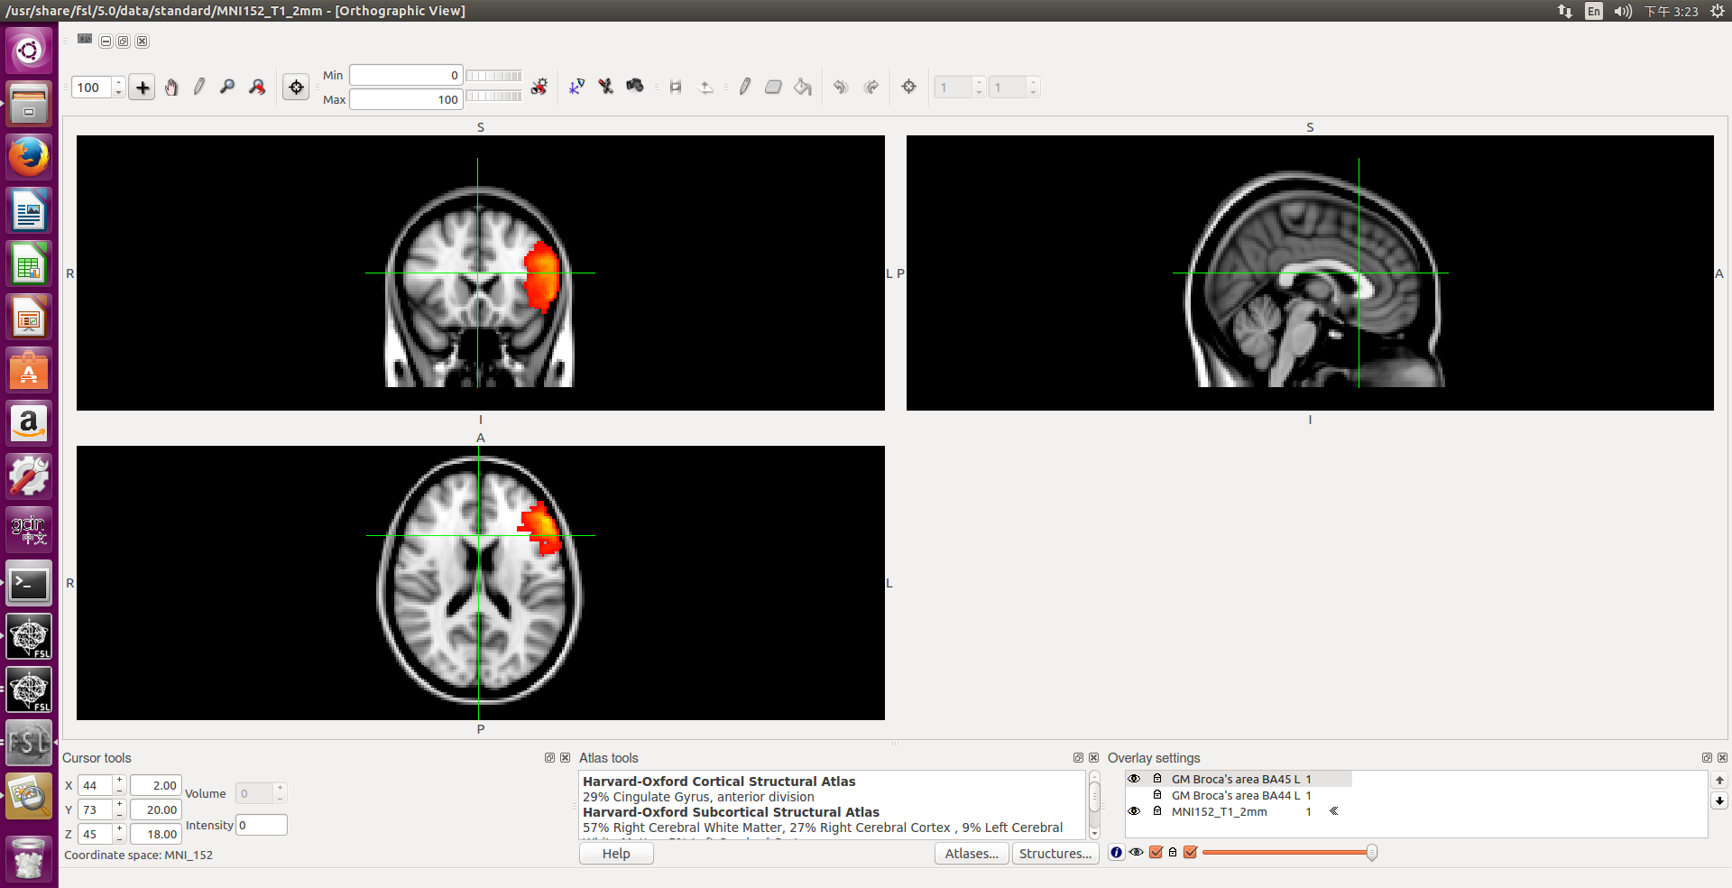
Example real fmri-fluency dataset

Slide 19
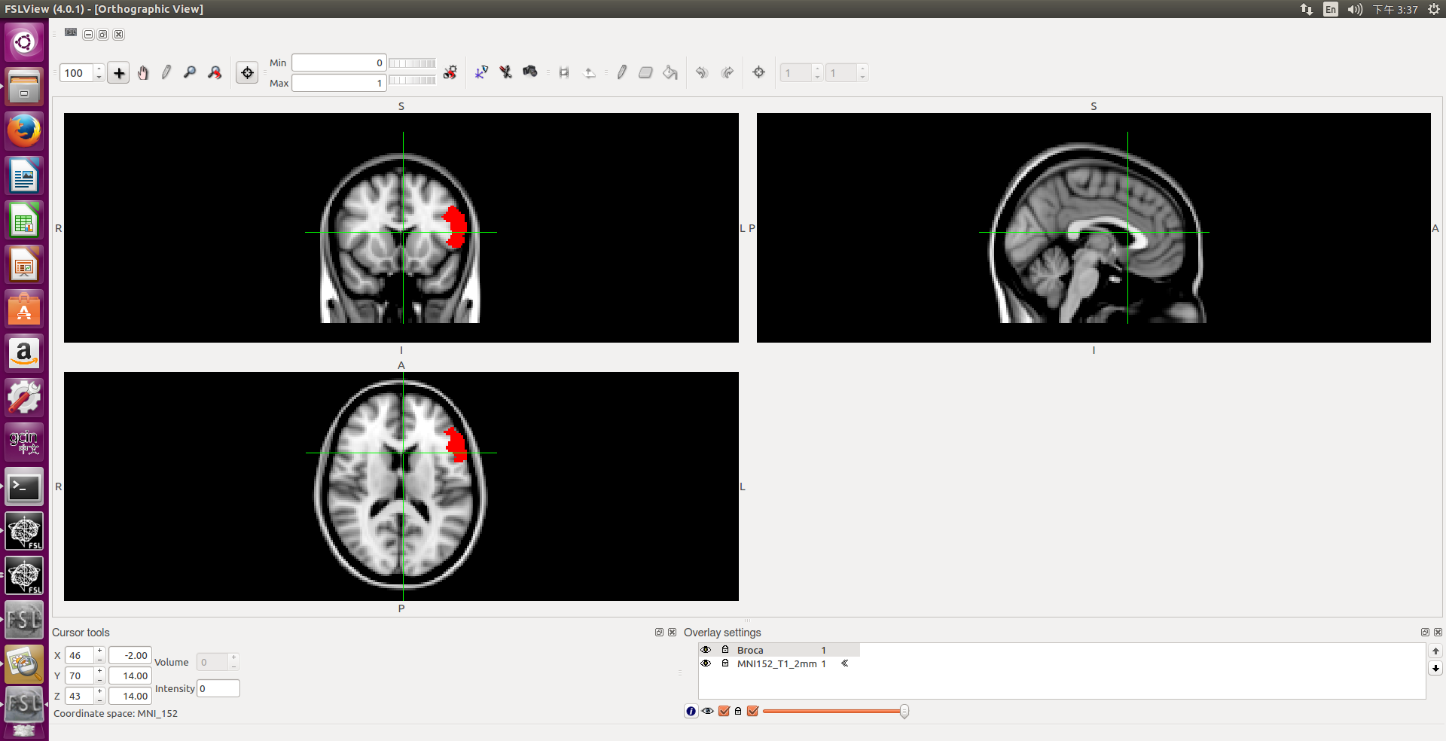
Example real fmri-fluency dataset
fslmaths BA44 -add BA45 -thr 50 -bin Broca
fslview $FSLDIR/data/standard/MNI152_T1_2mm -l Greyscale Broca -l Red

Slide 20
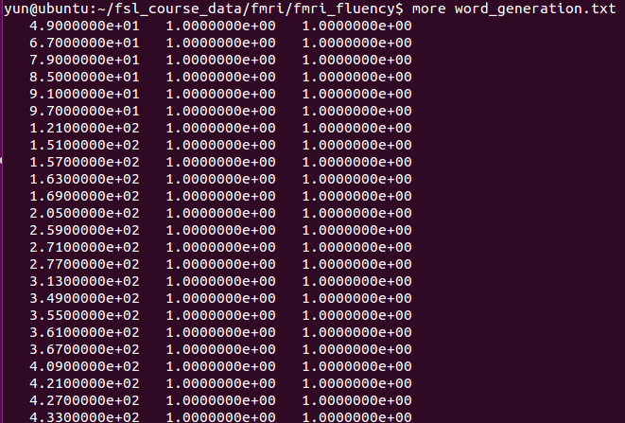
Example real fmri-fluency dataset

Slide 21
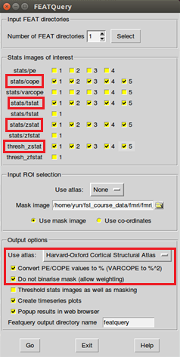
Featquery

Slide 22
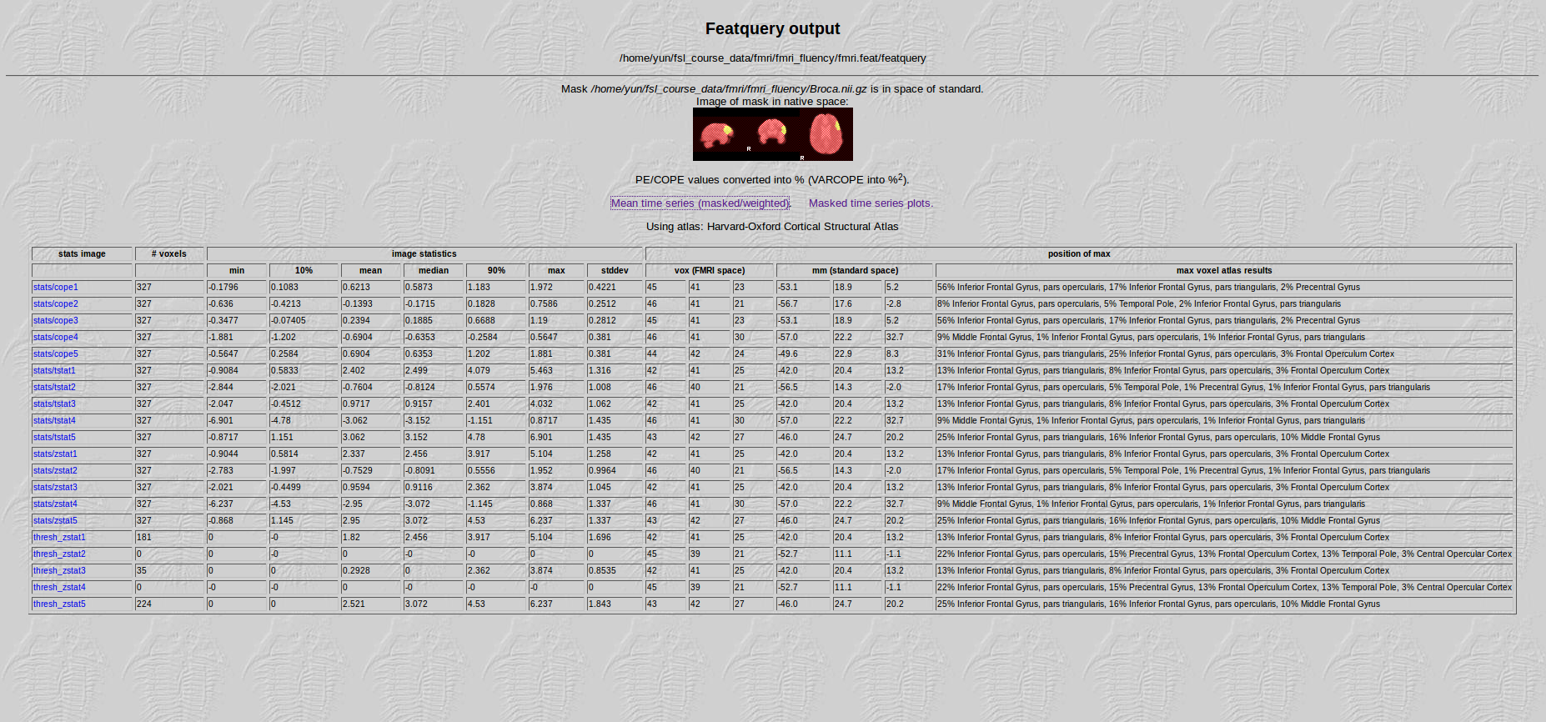
Featquery

Slide 23
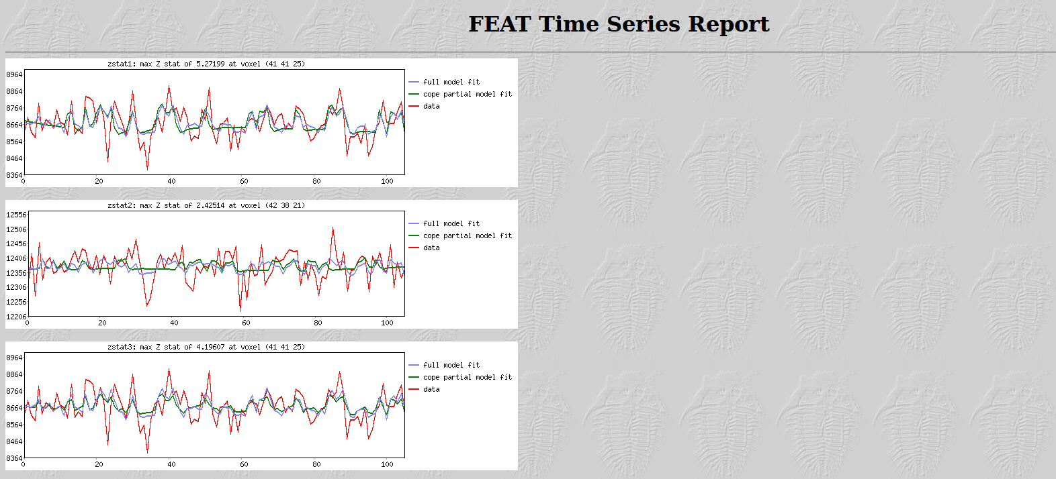
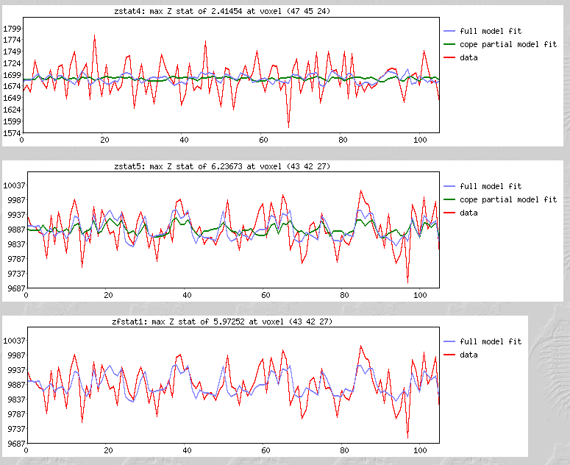
Featquery

Slide 24
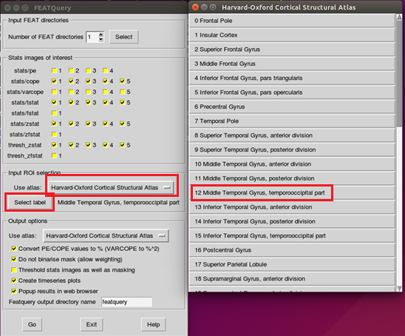
Featquery

Slide 25
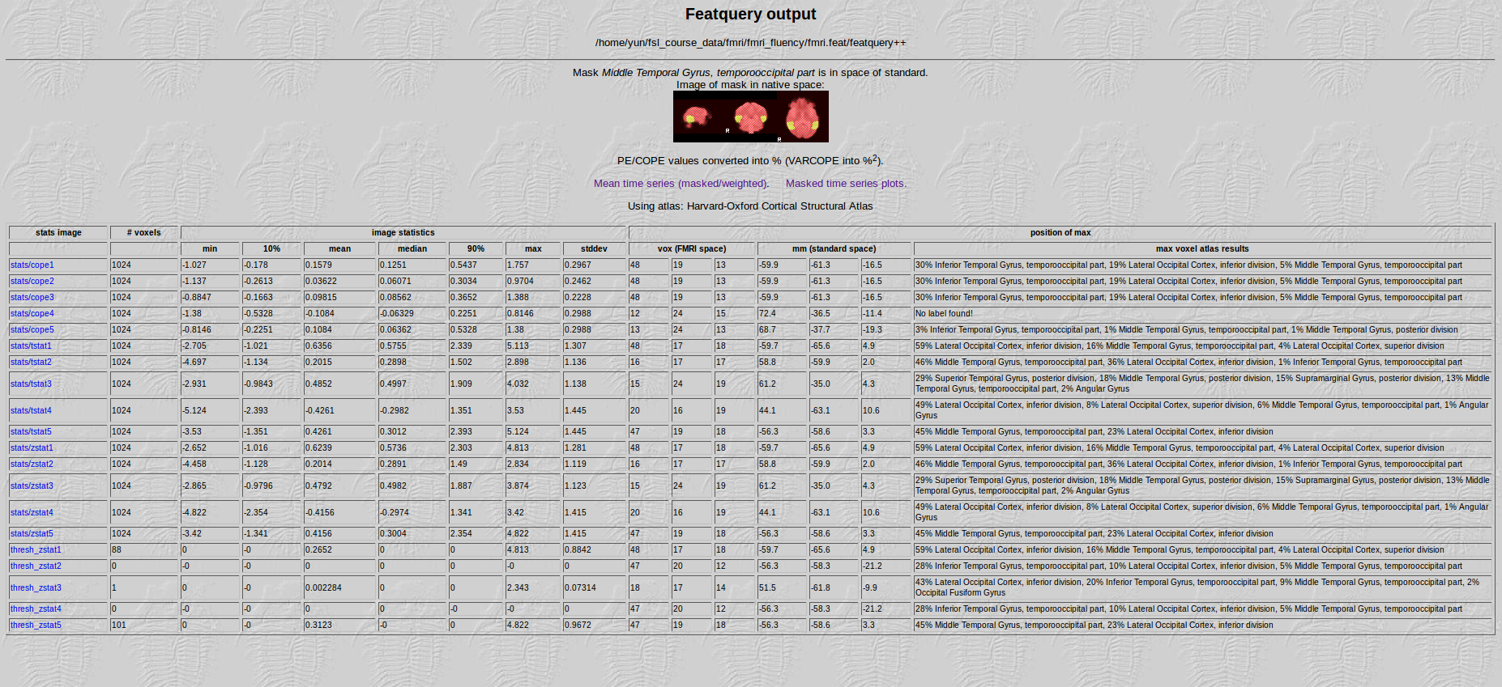
Featquery

Slide 26
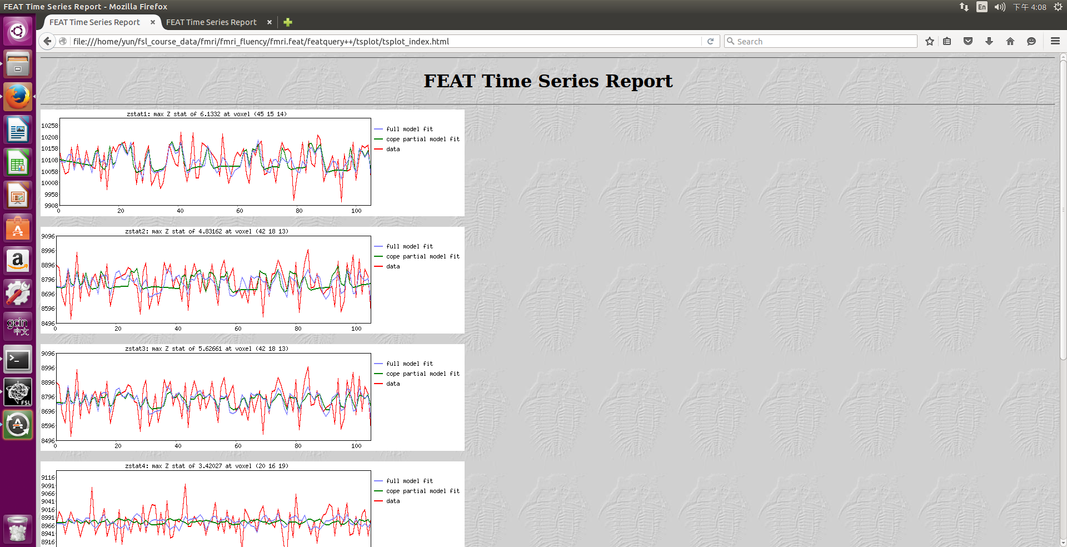
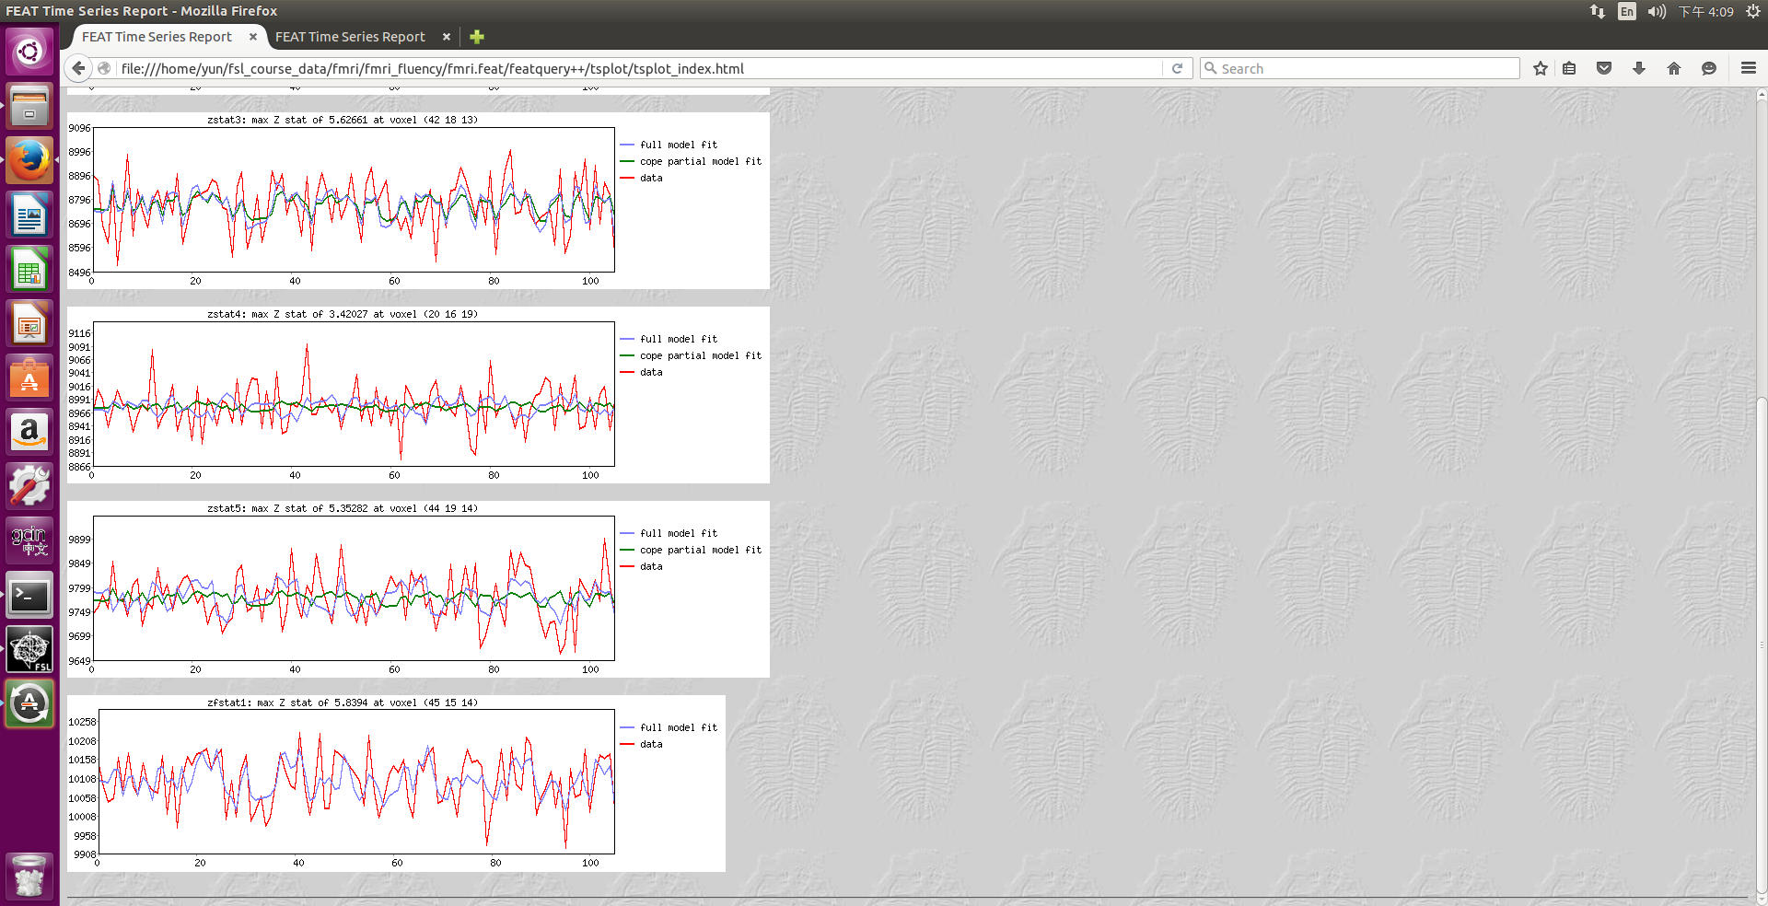
Featquery

Slide 27
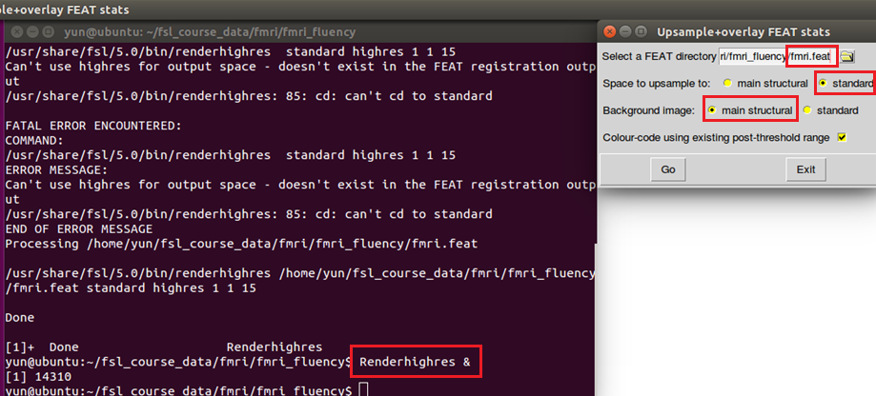
High-resolution Single-Session Overlays
Notes:
按下GO會出現一個hr的資料夾
as the images get resampled into high resolution using the "accurate", but slow, sinc interpolation method

Slide 28
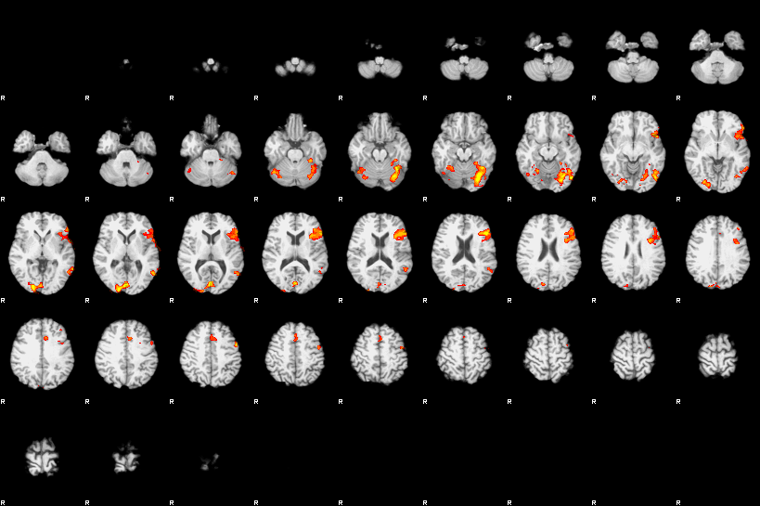
High-resolution Single-Session Overlays

Slide 29
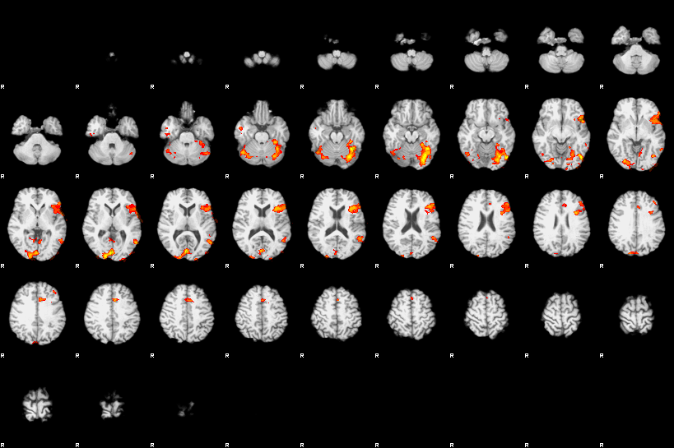
High-resolution Single-Session Overlays

Slide 30
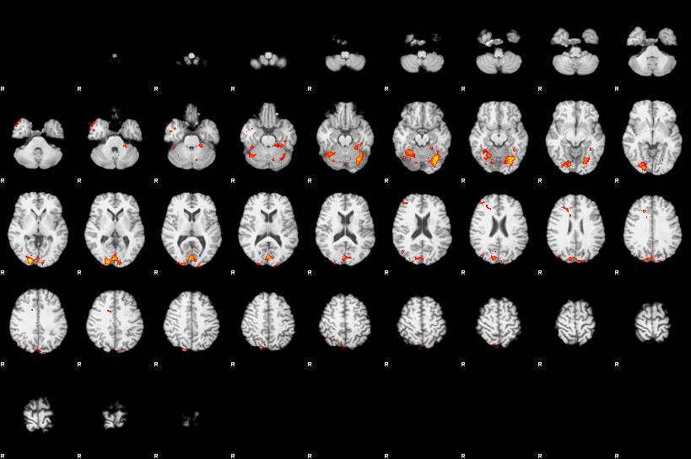
High-resolution Single-Session Overlays

Slide 31
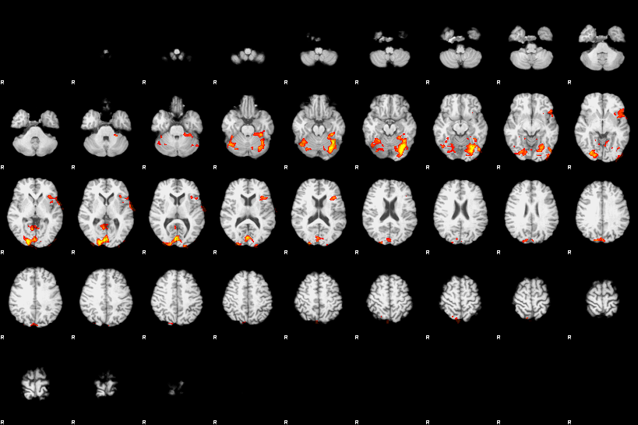
High-resolution Single-Session Overlays

Slide 32
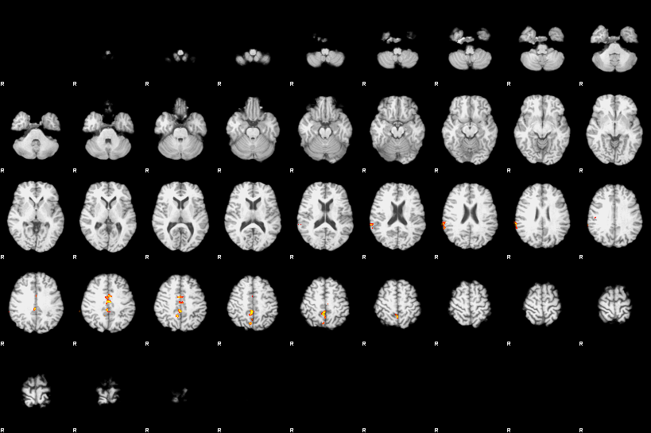
High-resolution Single-Session Overlays

Slide 33
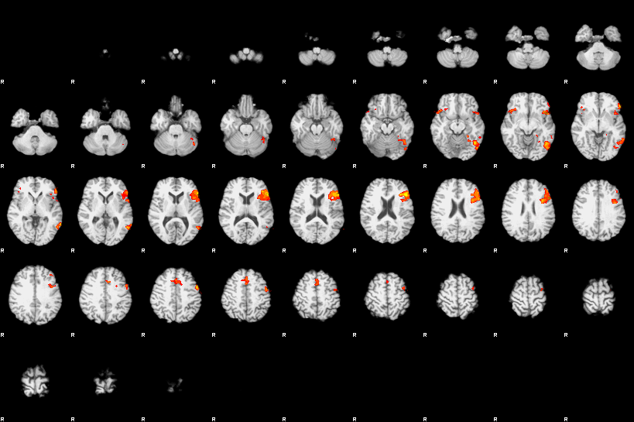
High-resolution Single-Session Overlays

Slide 34
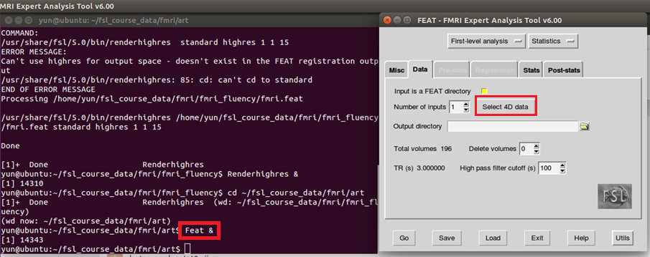
Custom Waveforms

Slide 35
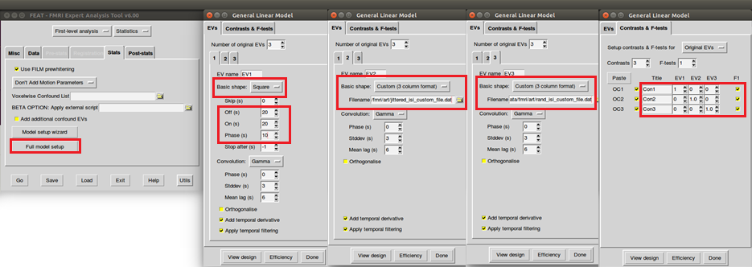
Custom Waveforms

Slide 36
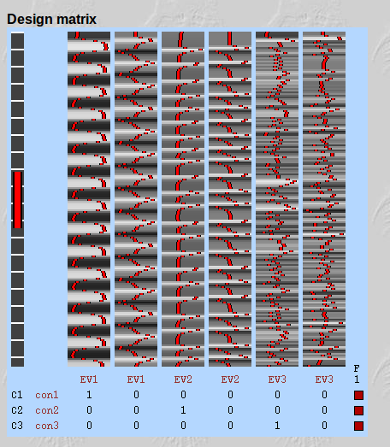
Custom Waveforms

Slide 37
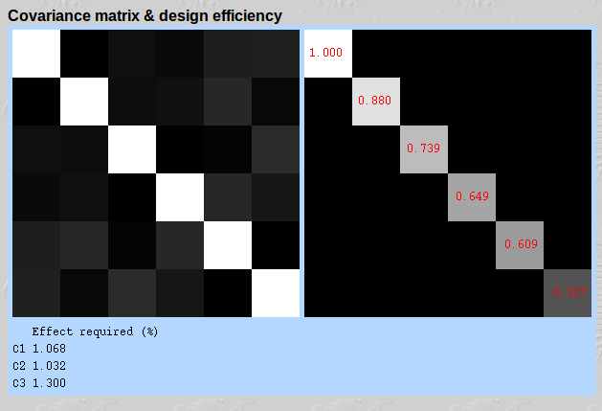
Custom Waveforms

Slide 38
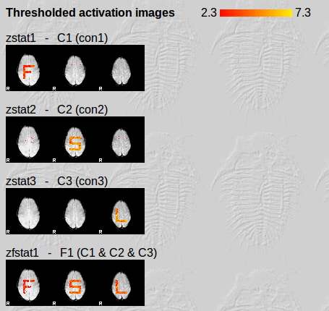
Custom Waveforms

Slide 39
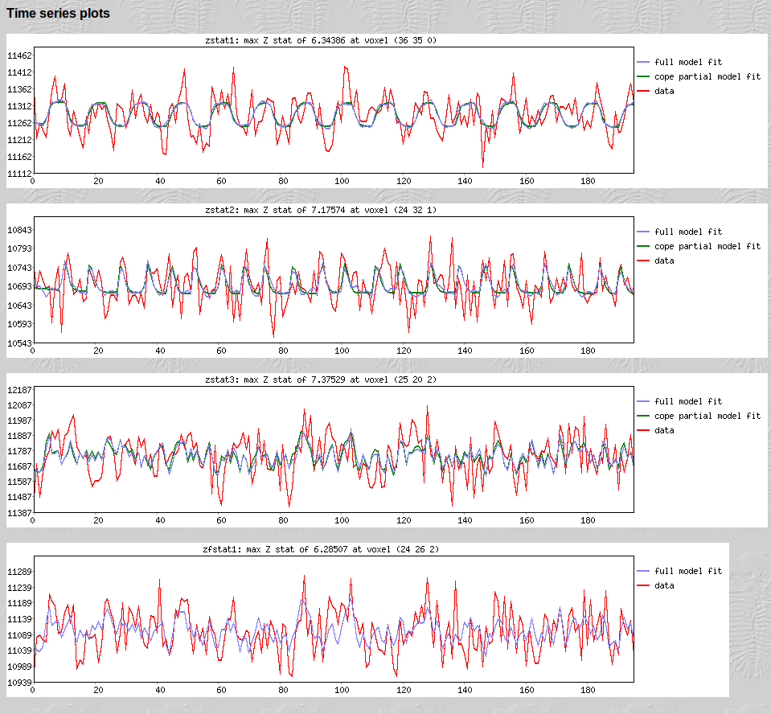
Custom Waveforms

Slide 40
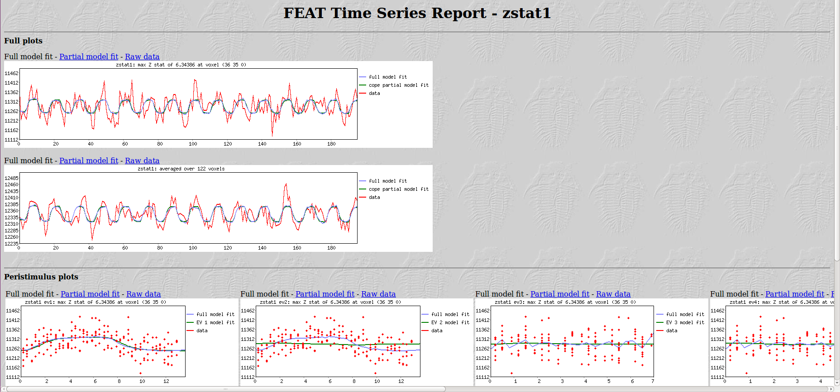
Custom Waveforms

Slide 41
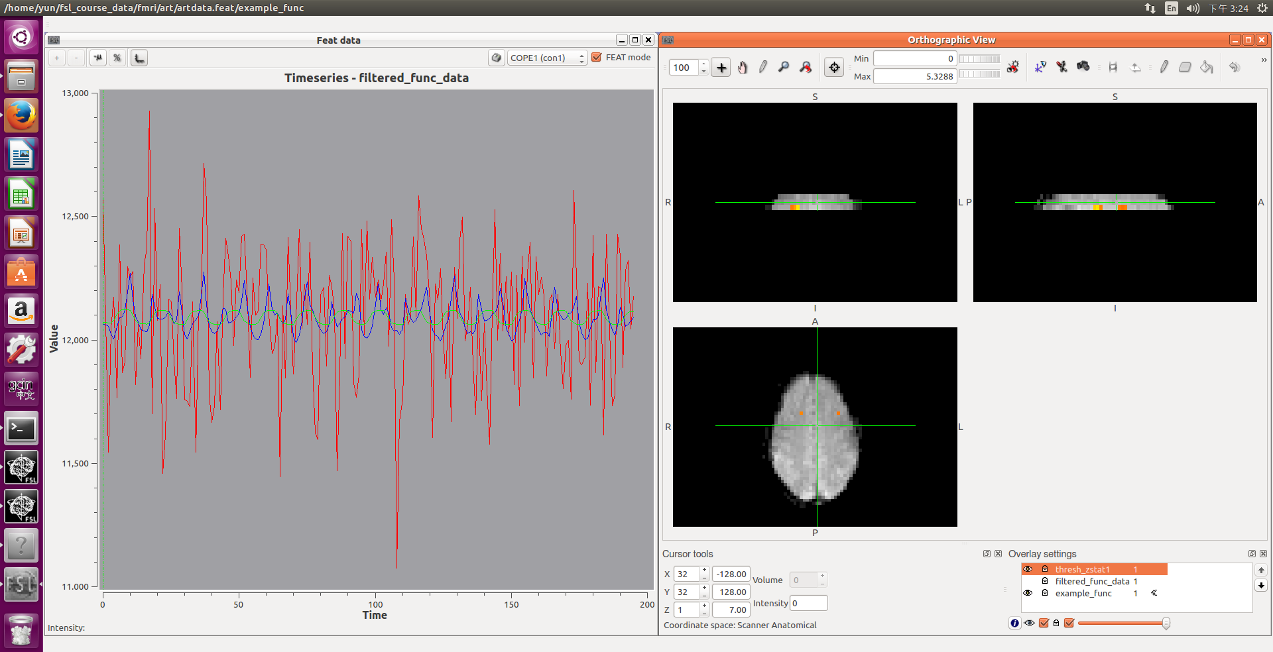
Custom Waveforms

Slide 42
The End
Thank you for your attention

